Slide 1
CSS Box Model
Dominic Ling
10 May 2014

Slide 2
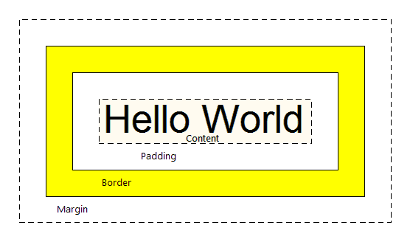
Margin - Clears an area around the border. The margin does not have a background color, it is completely transparent
Border - A border that goes around the padding and content. The border is inherited from the color property of the box
Padding - Clears an area around the content. The padding is affected by the background color of the box
Content - The content of the box, where text and images appear
In order to set the width and height of an element correctly in all browsers, you need to know how the box model works.

Slide 3
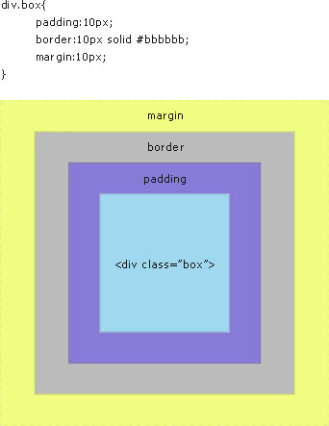

Slide 4
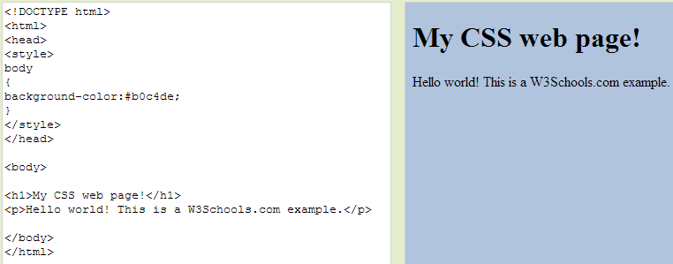
CSS Background

Slide 5
Links & Buttons
Dominic Ling
10 May 2014

Slide 6
CSS Links
Four links states:
a:link - a normal, unvisited link
a:visited - a link the user has visited
a:hover - a link when the user mouses over it
a:active - a link the moment it is clicked
http://www.w3schools.com/css/tryit.asp?filename=trycss_link

Slide 7
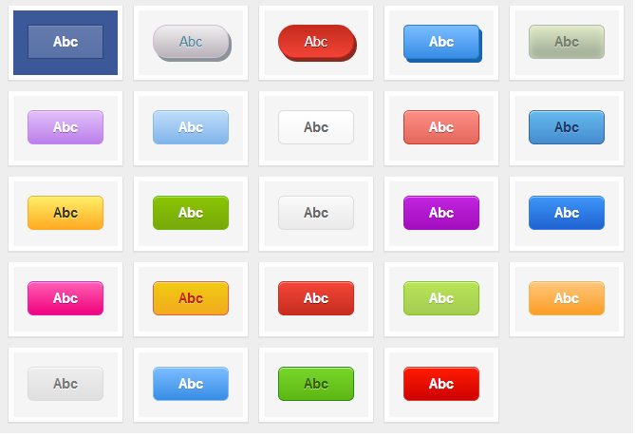
CSS Buttons

Slide 8
Try outs

